Slide 1
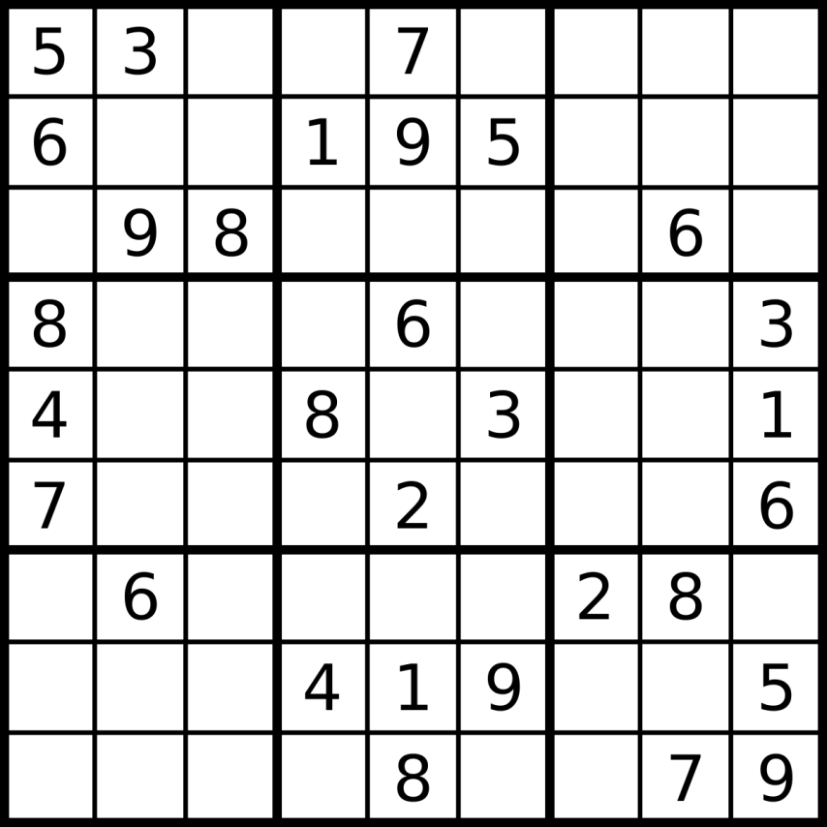
Sudoku
By Kaushik Malapati and Sanjeev Raja

Slide 2
Structure
Two different files which we merged at the end
Start with a basic puzzle, use scrambling techniques to make a new one
Color, letter, and number modes
Easy, medium, hard levels
Timed and scored with penalties for wrong answers
Two player mode with rewards/catch-up mechanic
Possible AI for two player mode

Slide 3
Roles
Sanjeev – Back-end logic , puzzle generation, selection square, number checks, scoring
Kaushik – user interface, graphics, enums, other controls

Slide 4
Progress
Instructions, selection of mode and difficulty, starting screen
One player mode finished
Two player mode incomplete
Basic Win-screen showing time and penalties
Timer running throughout game, not shown until end

Slide 5
Difficulties/Problems
Couldn’t display real time timer
Couldn’t use different threads for two player
Color mode always has one glitched square
Input lag
Fonts and styles being reset
y-value doesn’t start at 0
Need to update outtext before it displays anything
Inefficient, need to optimize if statements and functions
Selection square destroys things in path

Slide 6
Questions?

